Slide 1

Prepared by Group 3
Group Project
Work and Stress
13th February 2025

Slide 2







Team Members
Chris Dobbin
Ellen Liu
Pratishtha Theeng
Sarah Burnap
Jordan Dreyer
Member
Member
Member
Member
Member

Slide 3
Introduction
Work-related stress is physical and emotional strain experienced by individuals due to pressures and challenges in the workplace, such as heavy workloads, tight deadlines, job insecurity, and lack of support, which can negatively impact their health and job performance.

Slide 4

Analysis Objectives
Exploring the impact of Work-related Stress
Investigating how stress in the workplace affects employees’ well-being, productivity, and overall job satisfaction.
Understanding the Sources of Work Stress
Analyzing key stressors, such as workload, company size, gender, work model, work-life balance, physical activity and their correlation with performance and mental health.

Slide 5

Key Factors Influencing Corporate Workplace Stress
Gender
Does gender bias contribute to stress?
Personal Support
Does family help reduce stress? Does sleep or exercise help in alleviating stress?
How You Work
Does working remotely or being part of a smaller team increase stress level?

Slide 6
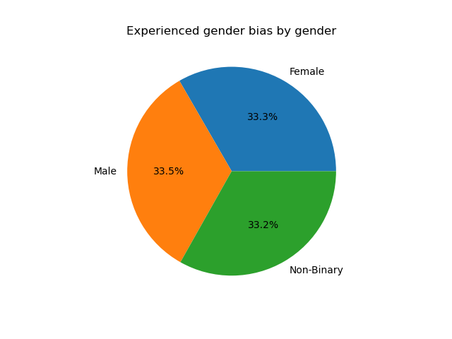
Individuals who have experienced gender bias grouped by gender
According to our data set, males make up a slightly higher proportion of individuals who have experienced gender bias, when compared to other genders.
However, in South Asian countries like India, non-binary and third gender identities are still considered taboo and are rarely addressed openly.

Slide 7
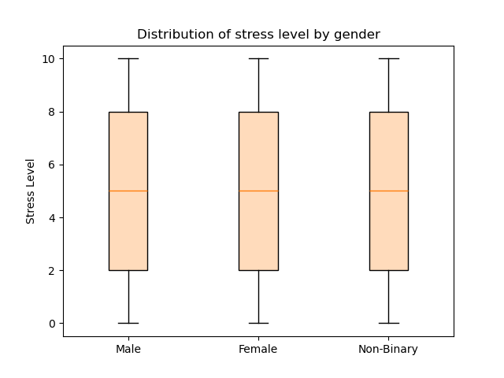
Stress level distribution grouped by gender
Each gender shows a uniform distribution of stress levels.
Possibility of the data being synthetic.

Slide 8
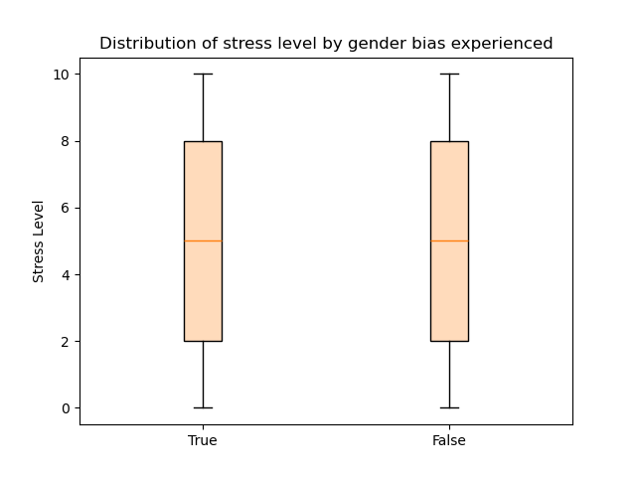
Distribution of stress level grouped by gender bias experience
The box plot illustrates the stress level distribution for individuals who have encountered gender bias versus those who have not.
It also illustrates a consistent distribution of stress levels within each group.

Slide 9
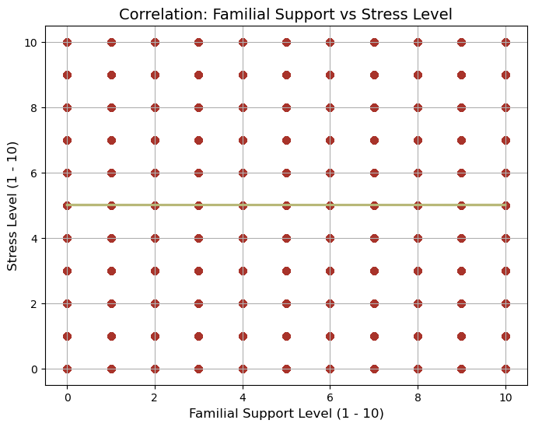
Familial Support and Stress
There is no correlation, if any, with this data set that there is an impact of Familial support on stress levels.
The data set is far too even, and there was little variance at all for this data sample.

Slide 10
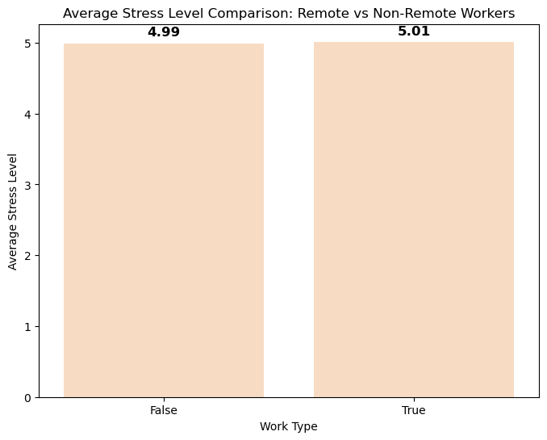
Work Model and Stress
On average remote workers tend to experience slightly more stress compared to non-remote workers.

Slide 11
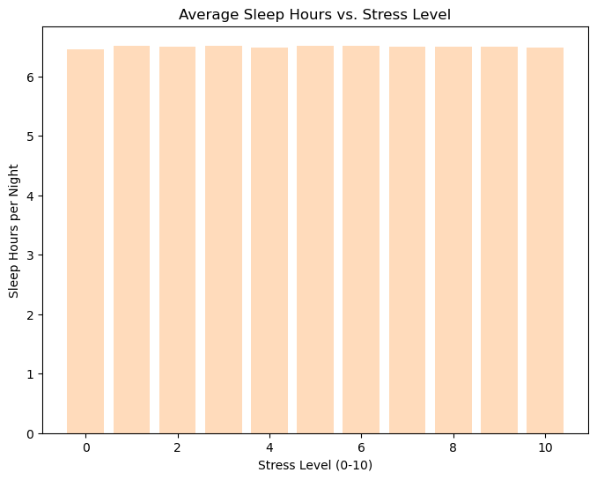
Average Sleep and Stress
How does sleep affect stress levels at work?
Less sleep has no impact on stress level.
The graph might not accurately reflect the real-world scenario.

Slide 12
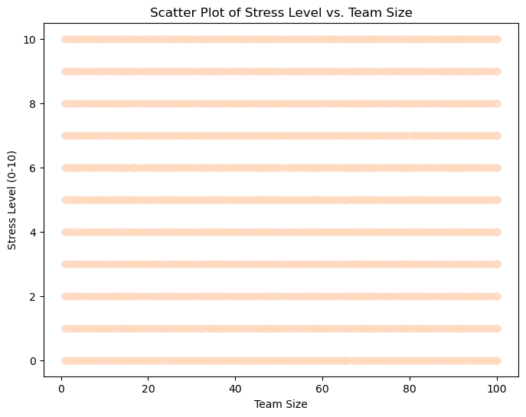
Impact of team size in Workplace stress
Does team size really impact
stress levels?
The scatter plot shows stress levels grouped into horizontal bands.
This suggests little to no variation in stress levels across the data.
In real-world data, we would expect a wider spread of stress levels.
The uniformity of the data indicates potential inconsistency.

Slide 13
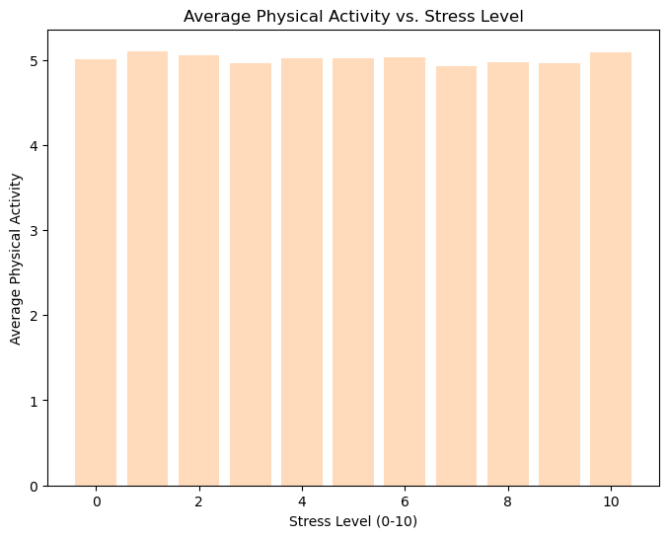
Correlation between physical activity and stress
Does the Gym help with
workplace stress?
Chart displays average physical activity at varying stress levels.
The lack of fluctuation indicates stress levels do not significantly affect physical activity.
The absence of variance is unusual findings.

Slide 14
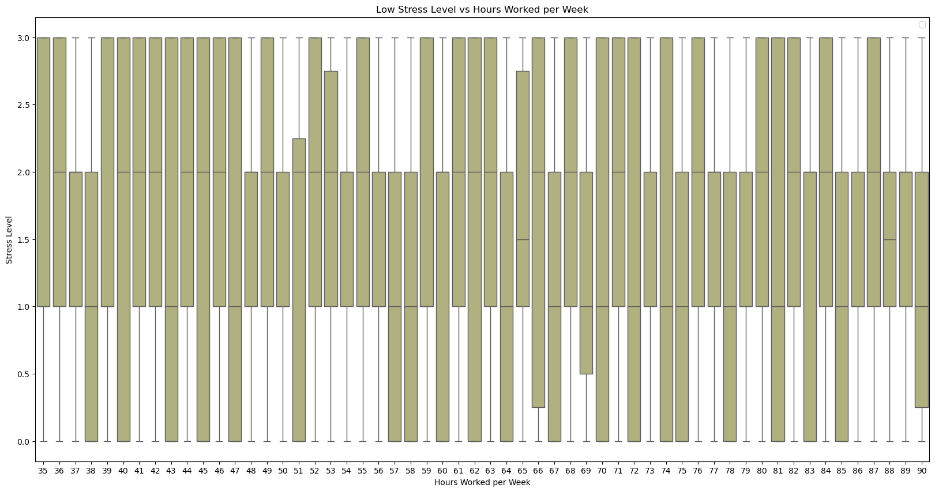
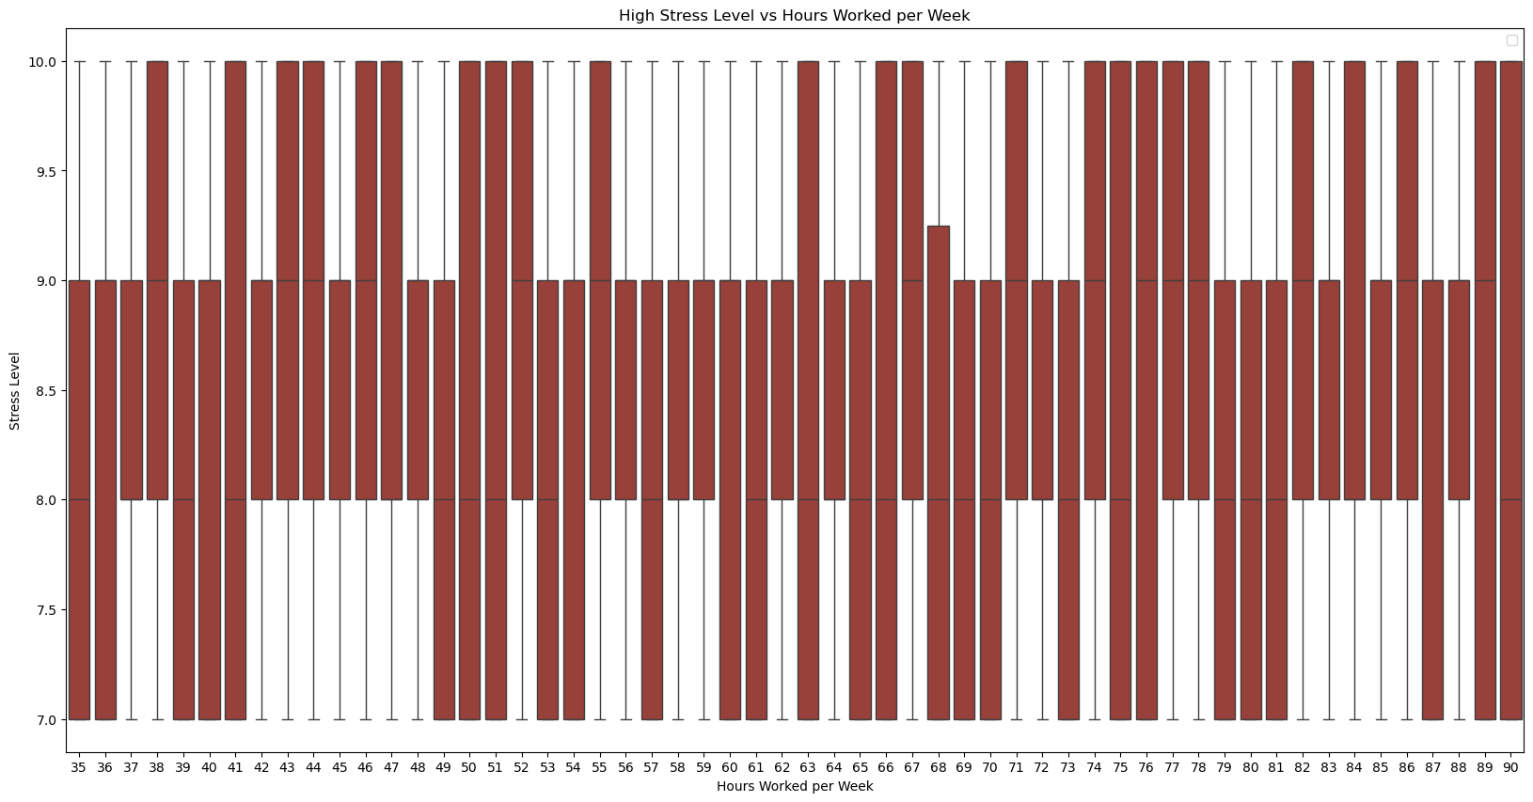
Low Stress Versus High Stress Reactions to Working Hours per Week
Based on these Visualizations, there is an even distribution of the two extremes: Low and High Stress.
Low Stress : 0 – 3: There is no definitive difference between more hours that were worked and lower stress levels, which is unusual.
High Stress : 8 -10: With a similar distribution of stress levels as the low stress individuals, there can be no judgement made on whether more hours worked correlates to higher stress levels.

Slide 15
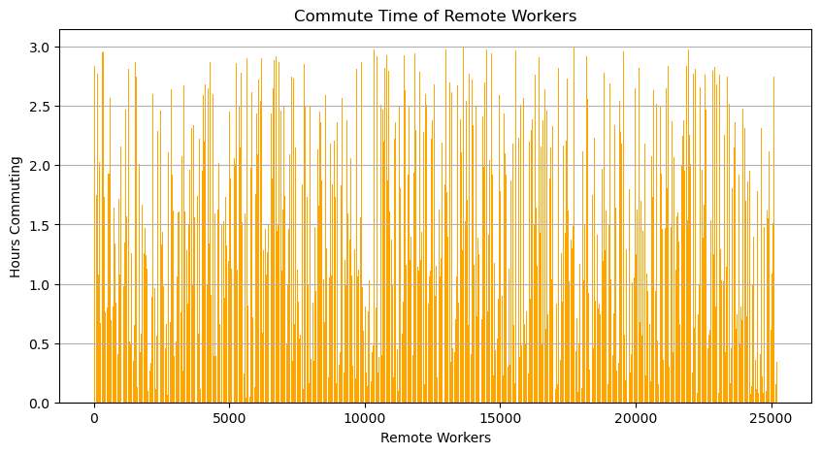
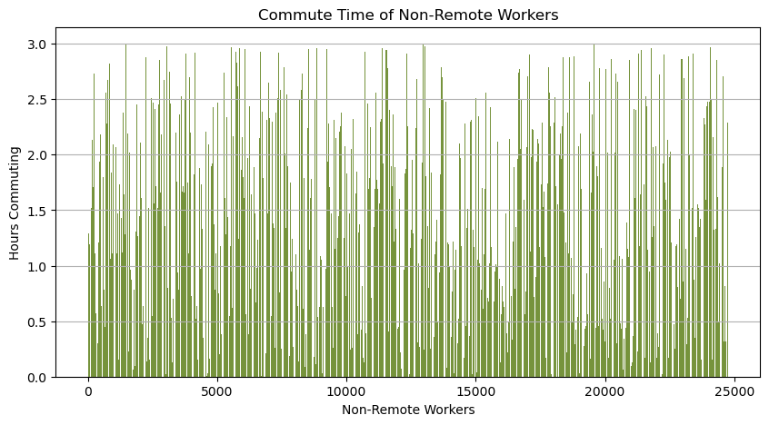
Commute time of Remote Workers and Non-Remote Workers
During our analysis concluding that the data set is not conclusive, we started searching for logical plot holes within the data. The biggest example was: Why do remote workers have commute times?
Facts to consider:
Remote workers make up 25234 individuals of our data set
Non- Remote workers make up 24766 individuals of our data set
In addition, why do we have an almost equal split of remote and non-remote workers?

Slide 16
All Possible Factors that Could Lead to Stress
Within this heat map, we can see all possible factors that could have contributed to our analysis. Every option is incredibly slim, with the greatest effect being Work Pressure Level at 0.008 degrees compared to the stress levels.

Slide 17
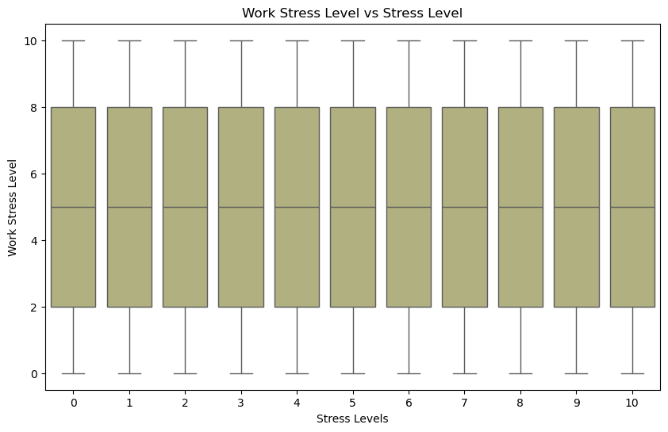
Work Stress Levels
Even with the highest correlation connection of 0.008 degrees to the overall stress levels of our individuals, there is still no difference in the breakdown to make an inference of a conclusion.

Slide 18
Conclusion
Initially, we anticipated uncovering significant correlations between stressors and their impact on performance and mental health. Our goal was to learn: "What Factors Contribute the Most to Stress?" by analyzing key stressors. However, upon reviewing the dataset, we found inconsistencies that rendered the data unreliable. As a result, we were unable to determine a definitive relationship between these factors and stress. This highlights the importance of accurate and high-quality data in stress-related research.

Slide 19
Thank you

